Slide 1


Machine Learning Perceptron Algorithm
Artificial Intelligence Training
Created by Andrew Ferlitsch Instructor July, 2017

Slide 2
Perceptron History
An early model for Linear Classification
Invented by Frank Rosenblatt in 1957
Early Predecessor to Neural Networks and Reinforcement Learning.
The goal of classification is to learn a function f(x) that
maps the features into labels y.
Binary Classifier: Predicts whether something belongs to a class or not.
Predictions based on combining set of weights with the
feature vector.

Slide 3
Limitations
Single Layer Perceptron
Has only one layer of nodes (vs. multiple layer neural networks).
Can only learn linearly separable classes.
Linear Separability:
Data can only be separated into classes by a decision boundary
2-Dimensional Vector -> Line
3-Dimensional Vector -> Plane
N-Dimensional Vector -> Hyperplane
Linearly Separable
Non-Linearly Separable
Line separates the data
Curve separates the data
X₂
X₂
X₁
X₁

Slide 4
Linear Separable Data
Binary Operations
X1 | X2 | AND | OR | XOR
0 | 0 | 0 | 0 | 0
1 | 0 | 0 | 1 | 1
0 | 1 | 0 | 1 | 1
1 | 1 | 1 | 1 | 0
Inputs
Outputs
Data is not separable
by a single line.
AND
OR
XOR
1
1
1
Data is separable
by a single line.
X₂
X₂
X₂
0
X₁
1
0
X₁
1
0
X₁
1

Slide 5
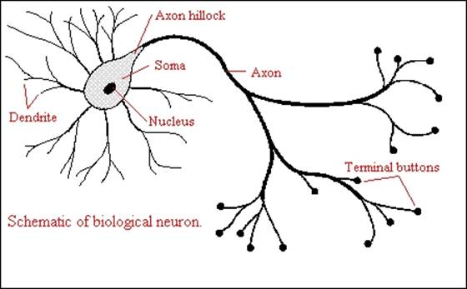
Symbolic Representation
Perceptron models a Brain Neuron
Diagram of a Neuron in the Brain
Inputs (Features)
Weights are learned and
applied to each feature.
X₁
W₁
Step Function
Output
X₂
W₂
∑
∫
-1 or 1
W₃
Squash the result
to either a -1 or 1
X₃
Summation of the products of weights and features.
W₀
X₀
This is the constant b in a
Linear equation, where x₀ is 1.

Slide 6
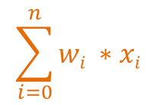
Symbolic Representation
Perceptron is a Linear Equation with a Step Function
$$\sum_{i=0}^{n}{wi ∗xi}$$
Inputs (Features)
X₁
W₁
Step Function
Output
X₂
W₂
∑
∫
-1 or 1
W₃
X₃
1 if w * x + b > 0
-1 otherwise
f(x) =
W₀
X₀

Slide 7
Algorithm
Inputs (Features)
Training
Data
X₁
W₁
Step Function
Output
X₂
W₂
∑
∫
-1 or 1
W₃
X₃
W₀
X₀
Adjust Weights
function Perceptron( data )
initialize weights to zero
repeat until convergence
for each sample in data
if y_{i} not equal to f(x_{i})
add ( y_{i} * x_{i} ) to all weights
Convergence occurs when the difference between
the last and current weight vectors is 0.
Rerun the training data each time the weights are updated.
Will be negative if y_{i} is -1
Other variants may add or subtract 1 to the weights.

Slide 8
Last Remarks
Pursuing Neural Networks languished until the 1980s,
once it was realized they could only handle linearly
separable data. It’s application was too limited.
Neural Networks resurged after:
Adding multiple output nodes,
Using other squashing functions (rectifiers, sigmoid),
Adding multiple hidden layers (Deep Learning).

